Slide 1
Pivotal Cloud Foundry
Jan 2017

Slide 2
PCF -DAY 04

Slide 3
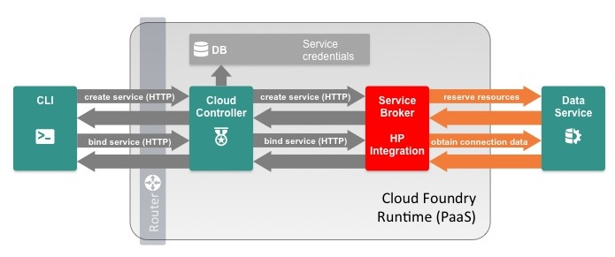
Service Broker
Services are integrated with Cloud Foundry by implementing a documented API for which the cloud controller is the client; we call this the Service Broker API.
Service Broker is the term we use to refer to a component of the service which implements the service broker API.
Service brokers advertise a catalog of service offerings and service plans, as well as interpreting calls for provision (create), bind, unbind, and deprovision (delete).

Slide 4
Service Broker
Implementation & Deployment
Cloud Foundry only requires that the service provider implement the service broker API. A broker can be implemented as a separate application, or by adding the required http endpoints to an existing service.
Because Cloud Foundry only requires that a service implements the broker API in order to be available to Cloud Foundry end users.
examples of valid deployment models.
Entire service packaged and deployed by BOSH alongside Cloud Foundry
Broker packaged and deployed by BOSH alongside Cloud Foundry, rest of the service deployed and maintained by other means
Broker (and optionally service) pushed as an application to Cloud Foundry user space
Entire service, including broker, deployed and maintained outside of Cloud Foundry by other means

Slide 5
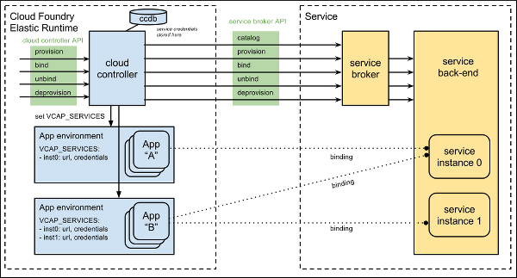
Service Broker

Slide 6
Managing Service Brokers
Steps make its services available to end users in all orgs or a limited number of orgs by service plan.
Register a Broker
Publish service plans to specific orgs or all orgs in the deployment. Can also keep plans unavailable, or private.
Created by admins, with the command
cf create-service-broker mybrokername someuser somethingsecure http://mybroker.example.com/
Managed by admins
Service plans are created private. Before anyone can use them, an admin must explicitly make them available within an org or across all orgs.
Make Plans Public
After an admin creates a new service plan from a standard broker, no one can use it until the admin explicitly makes it available to users within a specific org or all orgs in the deployment.

Slide 7
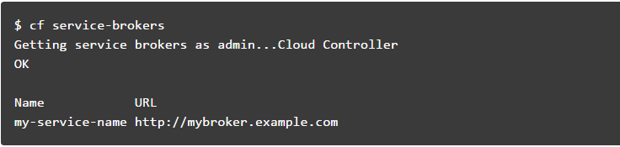
Service Broker
List Service Brokers
Update a Broker
Remove a Broker

Slide 8
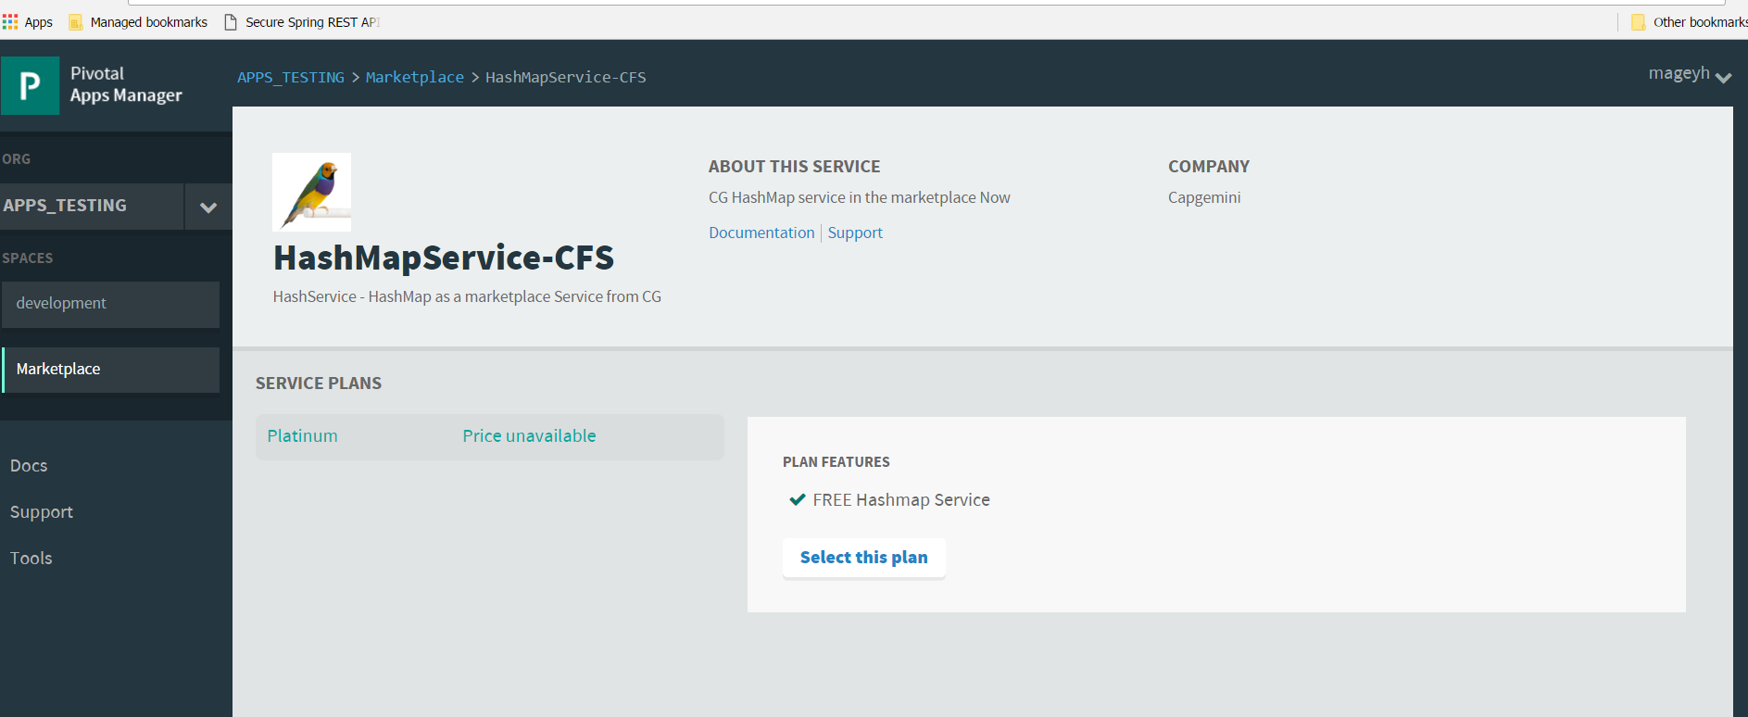
Service Broker
Creating Custom service and making it available in the Marketplace.

Slide 9
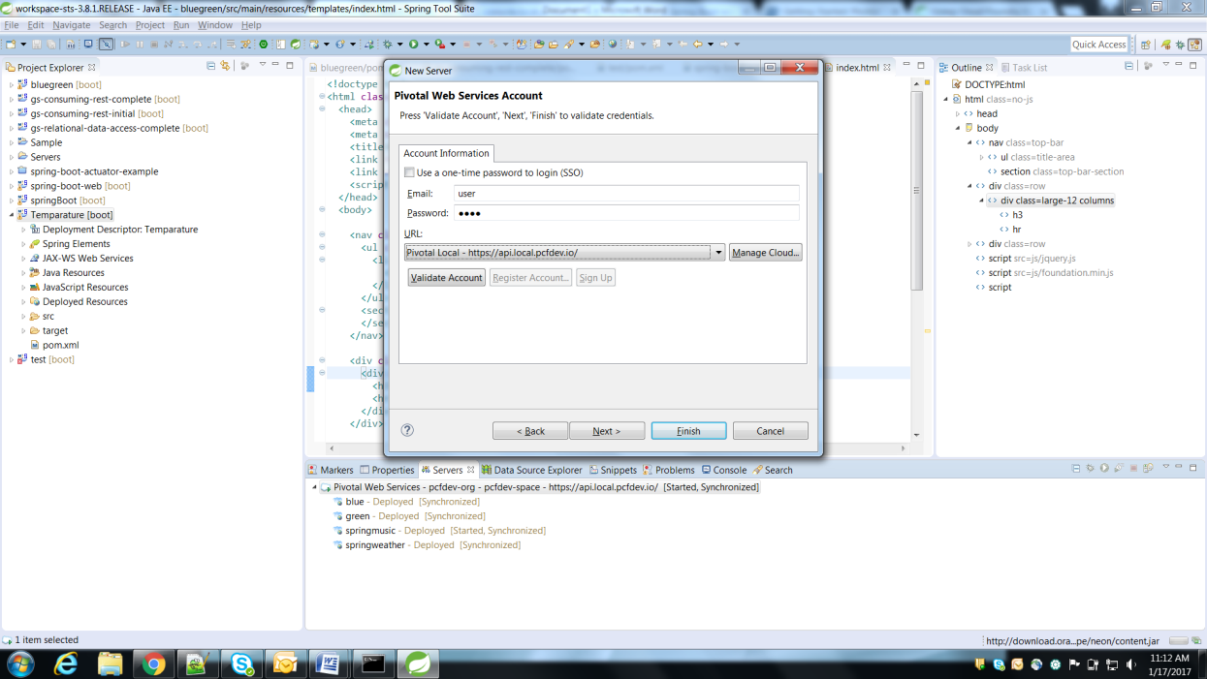
Push Apps through STS

Slide 10
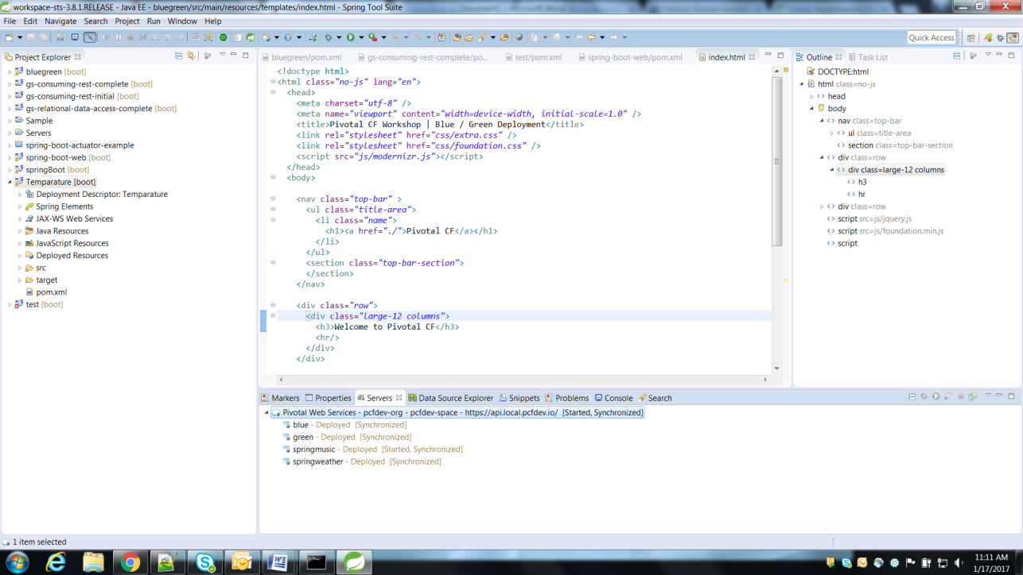

Slide 11
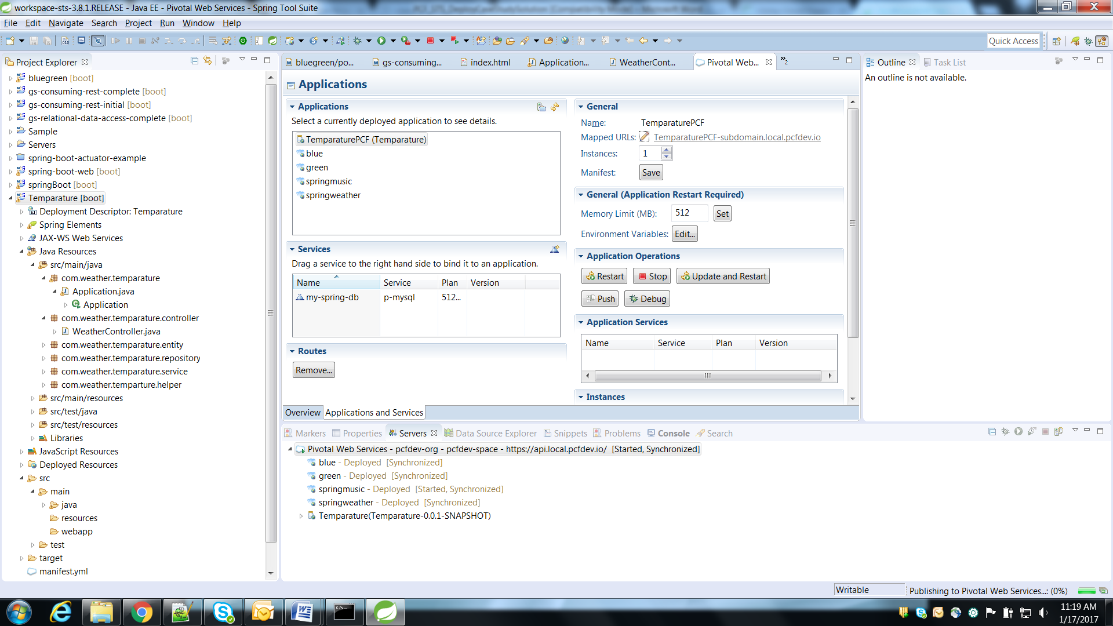
Push Apps through STS

Slide 12


Spring Cloud Services
An open-source library–makes it easy to develop JVM applications for the cloud.
Provides tools for developers to quickly build some of the common patterns in distributed systems.
Helps in building self healing distributed systems.

Slide 13
Common challenges for building Distributed System
As we decompose the system into many distributed processes, how do we consistently and reliably distribute configuration to these processes?
When that configuration needs to change, how do we update that configuration without redeploying all of the processes?
Once deployed in a cloud environment, processes will come and go and change their locations. How do we determine the locations of the processes that my process needs to collaborate with?
Once we’ve determined a set of possible locations of one of my process’s dependencies, how do we choose which process instance to communicate with next?
How do we prevent faults (when instances communicates), from cascading into a failure?

Slide 14
Spring Cloud Components
Service discovery : Spring Cloud Eureka
Client-side load balancing : Spring Cloud Ribbon
Declarative Rest Client : Spring Cloud Feign
Circuit breaker : Spring Cloud Hystrix
API gateway : Spring Cloud Zuul
Configuration : Spring Cloud Config
Tracing : Spring Cloud Slueth & Zipkin

Slide 15
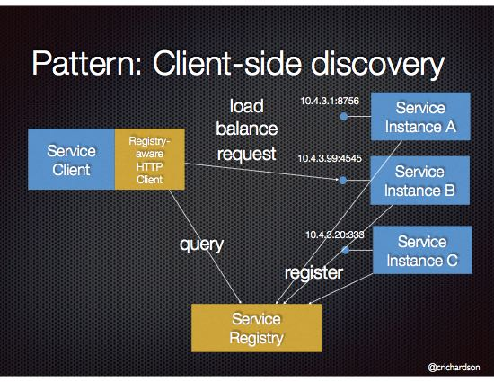
Service discovery : Spring Cloud Eureka
Problem : How does the client of a service - the API gateway or another service - discover the location of a service instance?
Eureka is a resilient service registry implementation. A service registry is one mechanism for implementing the Service Discovery pattern.

Slide 16
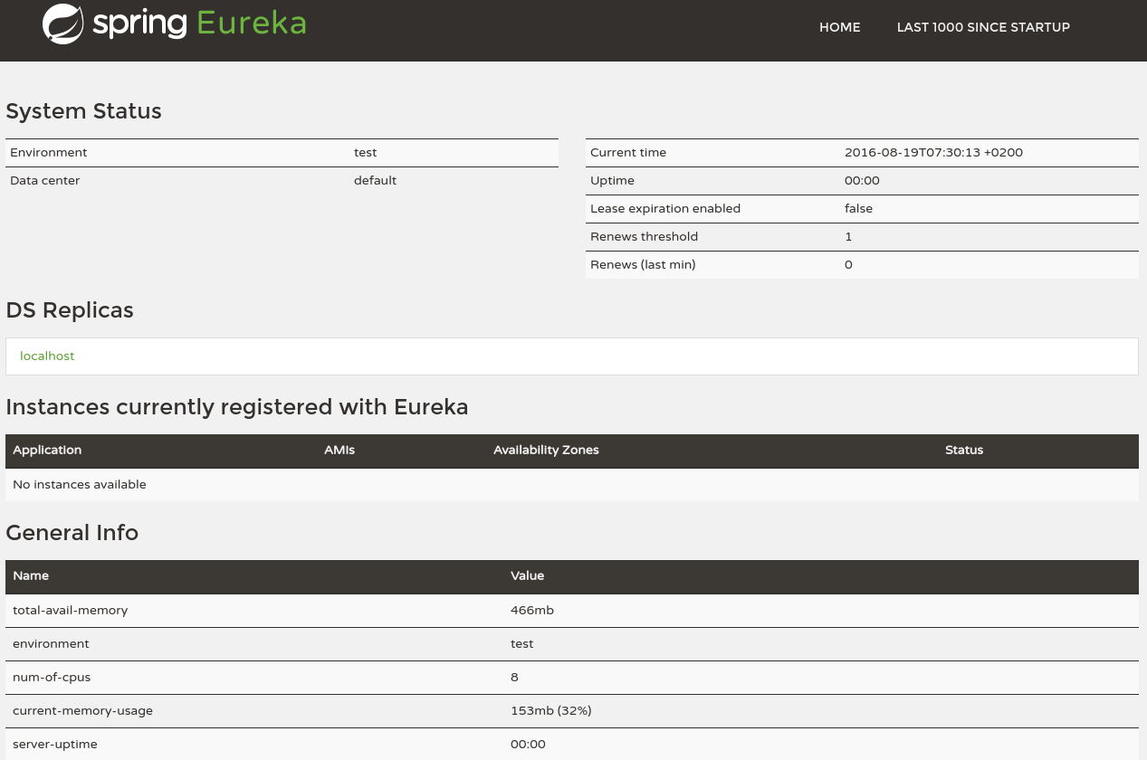
Eureka Server
Services register themselves with Eureka Server
Provide meta-data, such as host and port, health indicator URL, home page, etc
Eureka receives heartbeat messages from each instance belonging to a service. If the heartbeat fails over a configurable timetable, the instance will be removed from the registry
Provides Simple Interface .

Slide 17
Eureka Server
spring-cloud-starter-eureka-server as dependency
@EnableEurekaServer
Default port : 8761
Properties configuration
server.port=8761
eureka.client.register-with-eureka=false
Example :
@SpringBootApplication
@EnableEurekaServer
public class EurekaApplication {
public static void main(String[] args) {
SpringApplication.run(EurekaApplication.class, args);
}
}

Slide 18
Eureka Client
spring-cloud-starter-eureka as dependency
@EnableEurekaClient
Property Configuration
server.port=8761
eureka.client.serviceUrl.defaultZone= http://localhost:8761/eureka/
Example :
@SpringBootApplication
@EnableEurekaClient
public class EurekaApplication {
public static void main(String[] args) {
SpringApplication.run(EurekaApplication.class, args);
}
}

Slide 19
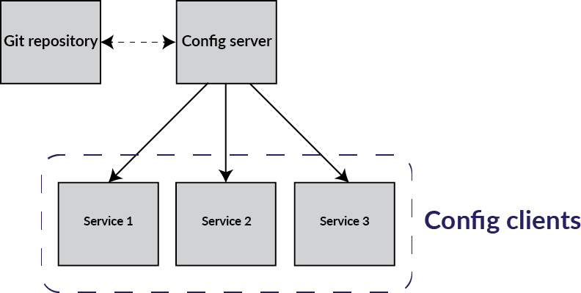
Configuration : Spring Cloud Config
Spring Cloud Config provides server and client-side support for externalized configuration in a distributed system.
Leverage a version control system as a configuration store, developers can easily version and audit configuration changes.

Slide 20
Config Server
To Setup the server
annotate the main application with @EnableConfigServer
add bootstrap.yml
add the repository uri in the key. spring.cloud.config.server.git.uri =
set the application name . spring.application.name=config-service
and the port . Server.port=8888
Example :
@SpringBootApplication
@EnableConfigServer
public class ConfigserverApplication
{
public static void main(String[] args)
{
SpringApplication.run(ConfigserverApplication.class, args);
}
}

Slide 21
Config Client
To Setup the client
add bootstrap.yml
set the application name. spring.application.name=config-client
add the uri to the cloud config server as below
spring:
application:
name: configclient
cloud:
config:
uri: http://localhost:8888

Slide 22
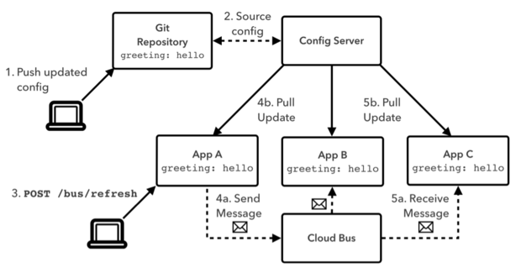
Spring Cloud Bus
Powerful mechanism for distributing configuration consistently across a set of application instances .
Provides ability to refresh application’s configuration without restart.
Links the services in a distributed system with a lightweight message broker (AMQP)

Slide 23
Circuit breaker : Spring Cloud Hystrix
Hystrix provides an implementation of common fault-tolerance patterns for distributed systems such as circuit breakers .
Use of the Circuit Breaker pattern can allow a microservice to continue operating when a related service fails, preventing the failure from cascading and giving the failing service time to recover.
When we apply a circuit breaker to a method, Hystrix watches for failing calls to that method, and if failures build up to a threshold, Hystrix opens the circuit so that subsequent calls automatically fail. While the circuit is open, Hystrix redirects calls to the method, and they’re passed on to our specified fallback method.
@EnableCircuitBreaker , @HystrixCommand , @EnableHystrixDashboard

Slide 24
Spring Cloud Hystrix
@HystrixCommand(fallbackMethod = "getProducerFallback")
public ProducerResponse getValue() {
return restTemplate.getForObject("http://producer", ProducerResponse.class);
}
private ProducerResponse getProducerFallback() {
return new ProducerResponse(42);
}
*Success|Short-Circuited|Timeout|Rejected|Failure|Error%

